Slide 1

HTML

Slide 2
HTML
HTML stands for HyperText Markup Language.
Markup Language just means it includes metadata for annotating the document (webpage) which is visually distinguishable from how the user sees the document.

Slide 3
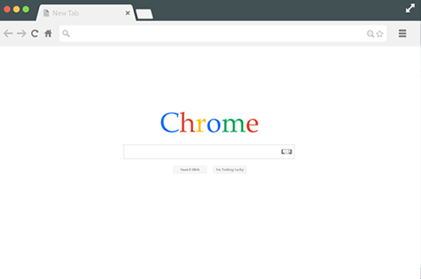
HTML
For example, when you visit a webpage, you’ll notice there is text on the page, but there is also text at the top of the tab.

Slide 4
HTML
For example, when you visit a webpage, you’ll notice there is text on the page, but there is also text at the top of the tab.

Slide 5
HTML
But how do we actually tell the browser which text goes where?

Slide 6
HTML
We simply “markup” the language text with instructions in the form of tags:
Defining a title in the tab:
<title>Title in Tab</title>
Defining text on the webpage:
<body>Text on page</body>

Slide 7
HTML
This section of the course focuses on understanding the most important and basic HTML content and tags.
Later on, we’ll see that Django can actually insert and automatically create this HTML content for us, but to understand what it’s creating, we need to understand the basic HTML first.

Slide 8
HTML
HTML Section Overview:
Basic Tags
Lists
Divs and Spans
Attributes
Tables
Forms

Slide 9
Let’s get started!

Slide 10
Basic HTML
and Tags

Slide 11
HTML
Let’s quickly explore the following:
Website Source HTML
Inspecting Individual Elements
Creating a simple .html file
Seeing that file in our browser

Slide 12
Lists

Slide 13
HTML
A common form factor on a page is a list, HTML has two main types of lists:
Ordered
Set with <ol></ol> tags
Is numbered
Unordered
Set with <ul></ul> tags
Uses bullet points

Slide 14
HTML
List items are denoted the same for either list using <li></li> tags.
Let’s check it out in our code editor and also explore how to preview the browser inside the editor.

Slide 15
Divs and Spans

Slide 16
HTML
Divisions in our HTML can be created with <div></div> tags.
These will allow us to separate out our HTML into different sections, which will become useful later when we want to apply certain styles to certain sections.

Slide 17
HTML
Spans are similar but they are used to create inline containers.
Spans use the <span></span> tags.
While it won’t be entirely clear what the effect of these tags are beyond organization, once we know CSS, we can use these tags to apply styles to only certain elements on the webpage.

Slide 18
Attributes with
Image and Anchor Tags

Slide 19
HTML
As we saw in the previous lecture, we can add attributes inside of HTML tags, like adding the style attribute and specifying a text color.
Typically we’ll define style attributes in a separate CSS file for organization.

Slide 20
HTML
Some HTML tags however need to have an attribute to function.
Examples include:
The Image Tag:
<img src= “example.png”>
The Anchor Tag:
<a href= “www.google.com”>Text</a>

Slide 21
HTML
Image tags allow us to show image files like .jpg or .png and Anchor tags allow us to link to other webpages.
Let’s explore some examples of these in our code!

Slide 22
Tables

Slide 23
Forms
Part One: Basics

Slide 24
HTML
When you visit a website, you may have noticed the URL starts with HTTP.
HTTP stands for Hypertext Transfer Protocol and is the protocol used to enable communication (HTML Transfer) between a client and server.

Slide 25
HTML
HTTPS just means that the HTTP is secured through encryption.
There are many methods available using HTTP, such as:
GET
Requests data from a source
POST
Sends data to a server

Slide 26
HTML
A typical user interacting with a webpage won’t be aware of GET and POST but still use them often when filling out a form on a page.
For example, a google search is filling out a form with a single text field and a submit button.

Slide 27
HTML
Forms are one of the most important HTML elements we’ll learn about since its the main way we will receive information from the client using the website.
Inside an HTML Form there are input tags and label tags, where the attributes play a large role in determining how they work.

Slide 28
HTML
The label tag dictates what the user can see on the Form page.
The input tag dictates what the user can actually provide as information.
Let’s explore these concepts inside our code editor!

Slide 29
Forms
Part Two: Input Selection Types

Slide 30
HTML
There are many different types of input selection we can setup for the user.
Let’s cover just a few of them here, keep in mind we’ll introduce more further along the course, but you can always check out the MDN web docs for more details on input types and attributes.

